Slide 1
Project Risk
PROJECT RISK PROFILE
PLAN RISK RESPONSES
QUALITATIVE RISK ANALYSIS
QUANTITATIVE RISK ANALYSIS
CONTROL RISK

Slide 2
PROJECT RISK AREAS
PROJECT
RISK
AREA
1
Product
2
Demand
3
Planning & Control
4
Project Team
5
Techno
logy
6
User

Slide 3
PROJECT RISK LIFECYCLE
Identification
Qualitative Analysis
Quantitative
Analysis
Mitigate, Manage, Accept
On going
Management
Scope : reengineering the flow and structure of visit the GP
Cost : critical risk, since the costs are very high at the beginning of the project
Benefit : for the 1st and 2nd year the tangible benefit and intangible benefit are small, because the expenditures to be used to make the system become stable
Business process flow : Failure of designing the business process will make a probability to produce an extra expenditures or even create unuseful system.
This failure will also make an impact that the project need to be reengineering
The most critical risk that applied in GP case is the used of cloud technology. The huge impact is the security policy, given an impact * probability as 0.25, the data leakage because of the blunder authorized access setup, will cost a fine and damage in the future
Mitigate : split the project work into small pieces of sprint with the most valuable outcome first during the milestone.
Manage : prevent and reduce the risk within clear organization requirements
Accept : some risks that out of human control can be accepted
Creating some company policies for risk management to include internal and external stakeholders regulation.

Slide 4
PLAN RISK MANAGEMENT
Risk Area | Risks | Responsibility
1. Product | 1. Error in estimating project size | Product owner
2. Demand | 1. Imprecise scope 2. Irregular changes of scope 3. Unpredictable process flow | Region HC delegate
3. Planning & Control | 1. Project resource underestimated 2. Time miscalculated 3. Overrun budget | Scrum master
4. Team | 1. Team turnover 2. Long hiring times 3. Conflict in a team | HR department Scrum master
5. Technology | 1. Lack of knowledge 2. Data leakage (unauthorized access) 3. Slow performance 4. Undersized network | IT Department
6. User | 1. User rejection 2. Technical support | Operation (GP, helpdesk, hospitals)

Slide 5
QUANTITATIVE RISK ANALYSIS
Risk | Impact | Prob | Value(Impact * Prob)
1. Lack of knowledge | 0.1 | 0.1 | 0.01
2. Data leakage | 0.5 | 0.5 | 0.25
3. Slow performance | 0.3 | 0.1 | 0.03
4. Undersized network | 0.1 | 0.2 | 0.02

Slide 6
PROJECT RISK PROFILE
Risk area | Risks description | Risk reduction action | Risk profile I = low risk ii = high risk a = critical risk
1. Product | 1.1 Error in estimating project size | 1.1.1. Consult industry experts
2. Demand | 2.1. Imprecise scope 2.2. Irregular changes of scope 2.3. Unpredictable process flow | 2.1.1. Consult industry experts Collect the requirements, 2.2.1. benchmarking 2.3.1. Collaborative approach, strong bonding with stakeholders
3. Planning & Control | 3.1. Project resource underestimated 3.2. Time miscalculated 3.3. Overrun budget | 3.1.1. Consult industry experts 3.2.1. Collect information from previous project 3.3.1. Provide any backup for budgeting
4. Team | 4.1. Team turnover 4.2. Long hiring times 4.3. Conflict in a team | 4.1.1. Collaborative support, strong bonding for each team member 4.2.1. Outsourcing 4.3.1. Team management support
5. Technology | 5.1. Lack of knowledge 5.2. Data leakage (unauthorized access) 5.3. Slow performance 5.4. Undersized network | 5.1.1. Support with internal and external training, provide certification 5.2.1. Establish security policy to form authorization 5.3.1. Establish automated system test to detect the trigger, refactoring the source code 5.4.1. Provide load balancer for scalability
6. User | 6.1. User rejection 6.2. Technical support | 6.1.1. Benchmarking 6.2.1. Good environment and facilities

Slide 7
PROJECT SCORING
Innovation
Uncertainty
Risk dimensions
Size: 22
Innovation: 17
Uncertainty: 9
Size

Slide 8
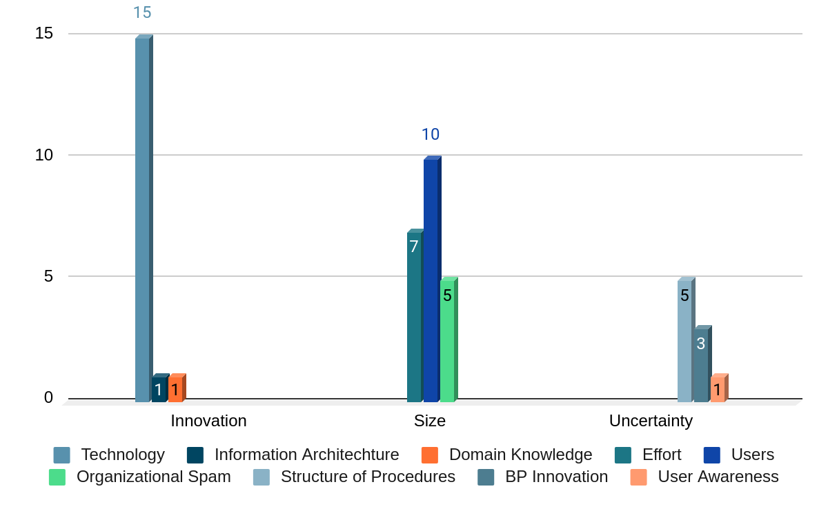
 | Technology | Information Architechture | Domain Knowledge | Effort | Users | Organizational Spam | Structure of Procedures | BP Innovation | User Awareness
Innovation | 15 | 1 | 1
Size |  |  |  | 7 | 10 | 5
Uncertainty |  |  |  |  |  |  | 5 | 3 | 1
PROJECT RISK SCORING
Low
Average
High

Slide 9
PROJECT RISK SCORING - COMMENT (I)
Innovation:
Technology is the most important part of this application, the data will be moved to the cloud with any disadvantages and advantages. There are some changes in business process although are not a significant change but the use of technology to make it feasible in order to make online meeting with a doctor is a high risk. Product owner and scrum master should considering the use of technology to provide some new services. The use of AI in the project is a component that involved in this high risk level.
Information/Execution architecture as the architecture will be using cloud system is a low risk, which the architecture already mature in the cloud system itself.
The domain/technology experience of IT professionals is a high risk, the projects need some professional with experiences in their field. general equal to the ones used before, but we must introduce some new professional figures.

Slide 10
PROJECT RISK SCORING - COMMENT (II)
Size :
efforts : the project will require 32 workweeks, if one week requires 40 hours of works, there will be 32 FTE to finish the projects, the value of efforts is 7 pts - average.
users : the size of users are very big, there are 7.000 of GP and 10.000 patients and some amount of 3rd parties user (lab, region and ministry) who will access the data by application.
organizational spam : the business process also including several functions that can be accessed by lab or vice versa, considering to the next phase of control and monitoring by region and ministry, the points of these scoring is 5 pts - average.
#
SIZE?
#

Slide 11

PROJECT RISK SCORING - COMMENT (III)
Uncertainty :
Structure of procedures : input , output and business rules are set with both law and regulation and stakeholders, the points given is 5 pts - average.
BP Innovation : some changes in innovation of business process with the existence of online meeting with the doctor in the next phase, rated as low - 3 pts.
User awareness : change readiness of the users is very huge risk since they are many users with different capability of using technology, they might reject the system or even don’t want to use the system, the risk rated 1 pts.

Slide 12
ORGANIZATION IMPACT
Impact / risk variables
Width
20
Management
30
Speed
50

Slide 13
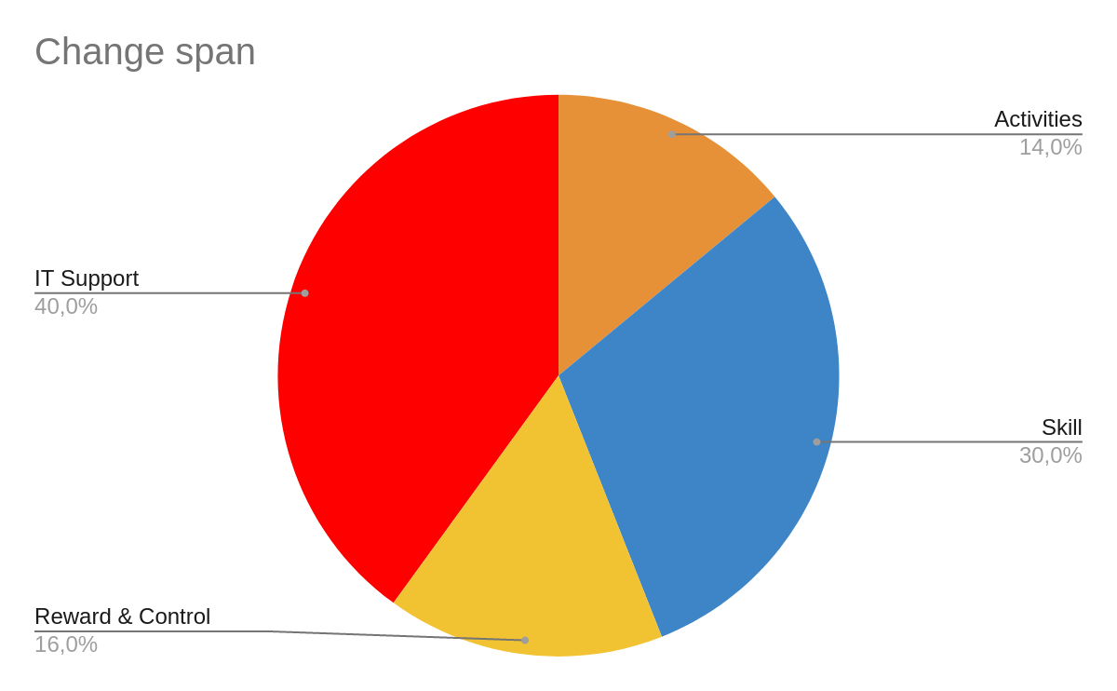
ORGANIZATION IMPACT : WIDTH (I)
 | Percentage | Weight
Activities | 14 | 2,8
Structure | 0 | 0
Skill | 30 | 6
Reward & Control | 16 | 3,2
IT Support | 40 | 8
Total 100 20
Width
20

Slide 14
ORGANIZATION IMPACT : WIDTH (I) comment :
ACTIVITIES
STRUCTURE
Change Span:
The activities are slightly changed, from the manual operation when the GP accept the patient and when the patients book and visit the doctor, also when the patient can do online meeting with the doctor.
No changes in an organizational structures.
There will be a huge percentage of the skills involved in this case, both GP and patient should be familiar with the used of the software.
From the first phase, there will not a big deal with reward and control, but consider to the next phase when reward and control can be a keypoint to build a reputation and provide a good governance policy to protect both patient and GP.
IT support as the most important impact in this field, as a new system released to provide knowledge support for operational and technical issues.
SKILL
REWARD&CONTROL
IT SUPPORT

Slide 15
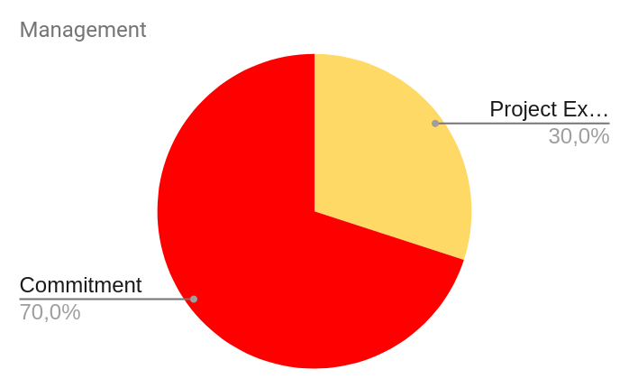
ORGANIZATION IMPACT : MANAGEMENT (II)
 | Percentage | Weight
Project Experience | 30 | 9
Commitment | 70 | 21
Total 100 30
Management
30

Slide 16

ORGANIZATION IMPACT : MANAGEMENT (II) comment :
Commitment?
Management preparation :
The experiences of the team member is in the middle area, but high quality scrum master and product owner in the agile development of GP application are needed, the mature and stable both key leader will affect to the experiences of all team members, mentoring is required.
The most important point in this preparation is the level of commitment from the team members, to build a continous good service and operation in the future, the team members must dedicated theirself in the project, to prevent some losses in the period of hiring and tutoring a new member. No high people turnover expected.
Experience of team member?

Slide 17
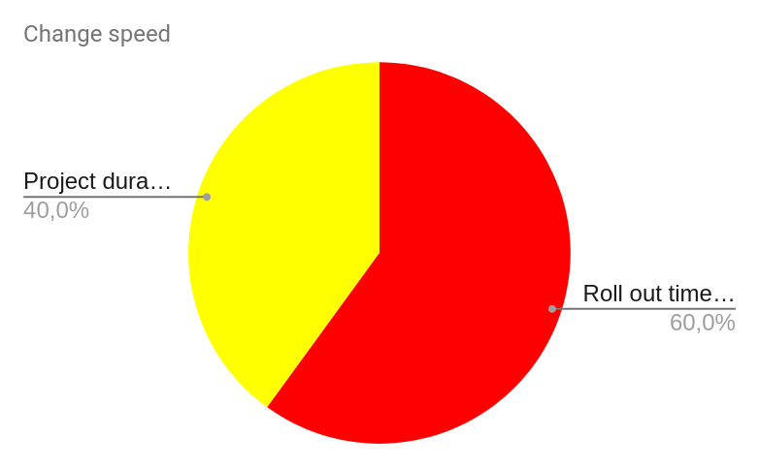
ORGANIZATION IMPACT : SPEED (III)
 | Percentage | Weight
Roll out time short | 60 | 30
Project duration short | 40 | 20
Total 100 50
Speed
50

Slide 18

ORGANIZATION IMPACT : SPEED (III) comment :
Change speed
The rollout time divide into some sprint which is takes short time to release as seen in the project milestone, as the project considering as a prototype with the most valuable component first ( user can do booking online ), so it will launched part by part and take some feedback from a quality assurance.
The project duration of this project is around 8 months, which is contains 20 sprints and 5 new sprint rollouts (if the are changes or additional user stories).

Slide 19
RISK MITIGATIONS
INNOVATION
SIZE
UNCERTAINTY
System
Project
System
Project
System
Project
Downgrade innovation
Excellent experts
Focus on core
Gradual releases
Copy
Piloting
Milestones
Excellent experts
Spec freezing
Strong project office
Focus groups
ANALYZED
Strong planning and control
Agile approach
NOT ANALYZED (non critical)
Change management

Slide 20

RISK MITIGATIONS - COMMENTS (I)
Innovation:
It is not necessary to downgrade the innovation since the changes are not complex, the factor analyzed is excellent experts, related to the high risk in technology, whereas the mitigation of this factor by getting a knowledge from excellent experts.

Slide 21
RISK MITIGATIONS - COMMENTS (II)
Size:
For the milestones and the gradual releases of the GP Project , they have already been applied and described above.
Product owner and scrum master are the key role who can efficiently administer the project, doing the planning and control changes.
#
SIZE?
#

Slide 22
RISK MITIGATIONS - COMMENTS (III)
Uncertainty:
The existence of some excellent experts will help in order to complete the projects on time and tutoring the team member and direct them to do the align task and create a strong bonding around user’s environment.
Agile approach will help the team to achieve the goal effectively and efficiently since there is daily meeting to communicate the difficulties and problems that happen during the project.
TEST
DEPLOY
DEVELOP
AGILE
DESIGN
REVIEW
REQUIREMENTS

